Slide 1
WoodWisdom-Net Seminar – Edinburgh 4-5 April 2017
DuraTB
Durable Timber Bridges
Kjell Arne Malo, NTNU
(Norwegian Univ. of Science & Technology)
Notes:
I

Slide 2
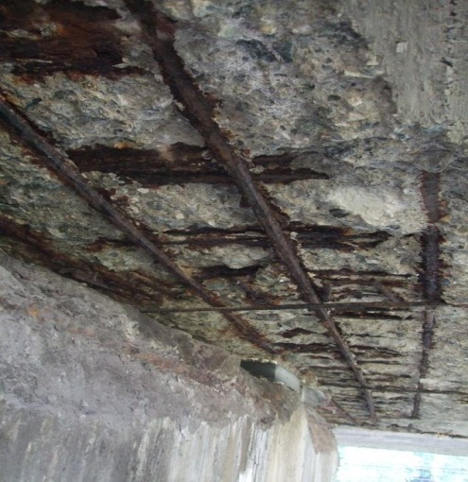
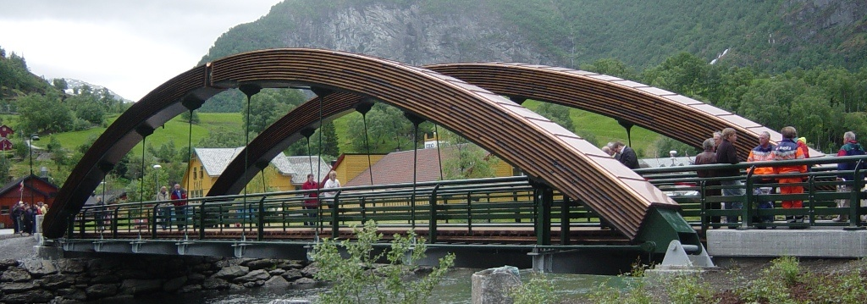
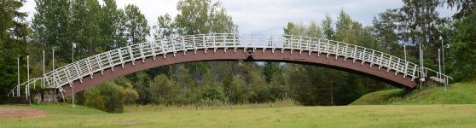
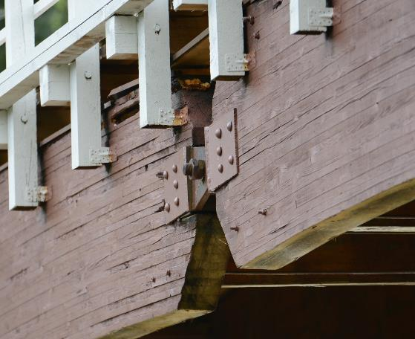
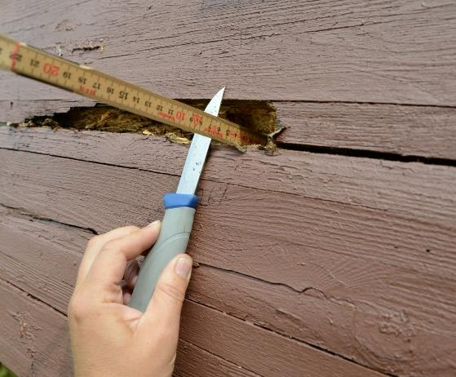
WoodWisdom-Net Seminar – Edinburgh 4-5 April 2017
To develop durable timber bridges with a given estimated technical lifetime.
  Norway: 16000,
  Sweden: 20000, Finland : 15000,
  + + +
  <idea and background of the project>
Notes:
I

Slide 3
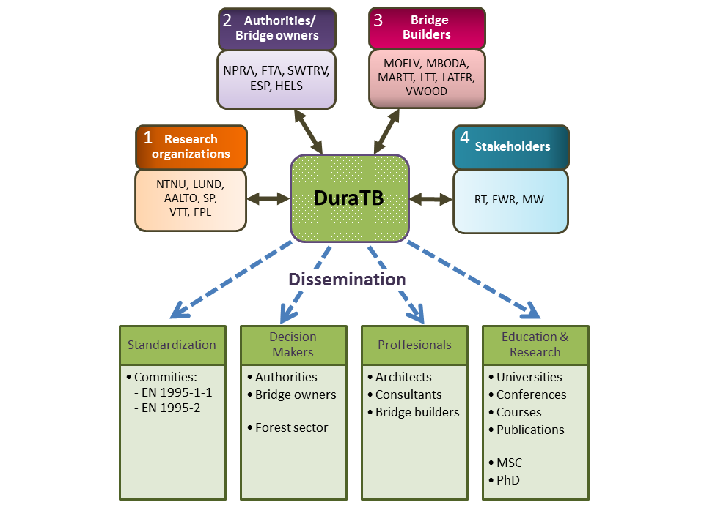
4 countries:
Finland
Norway
Sweden
USA
WoodWisdom-Net Seminar – Edinburgh 4-5 April 2017
Country | Role | Partner
Norway | 1 | NTNU Norwegian Univ. of Sci. and Tech.
Norway | 3 | Moelven Limtre AS
Norway | 2 | Norwegian Public Road
Finland | 1 | VTT technical research centre of Finland
Finland | 1 | Aalto University
Sweden | 1 | SP Technical research Institute of Sweden
Sweden | 1 | Lund University
Sweden | 3 | Moelven Töreboda AB
Sweden | 3 | Martinsons Träbroar AB
Sweden | 3 | Limträteknik AB
Sweden | 2 | Trafikverket (Swedish Road Authorities)
Finland | 2 | Finnish Transport Agency
Finland | 4 | Confed.of Finnish Constr. Industries RT
Finland | 4 | Finnish Wood Research OY
Finland | 3 | Versowood OY
Finland | 3 | Late-Rakenteet OY
Finland | 4 | MetsäWood
Finland | 2 | City of Espoo
Finland | 2 | City of Helsinki
USA | 1 | US, Dep. of Agric. Forest Products Lab.
Notes:
I

Slide 4
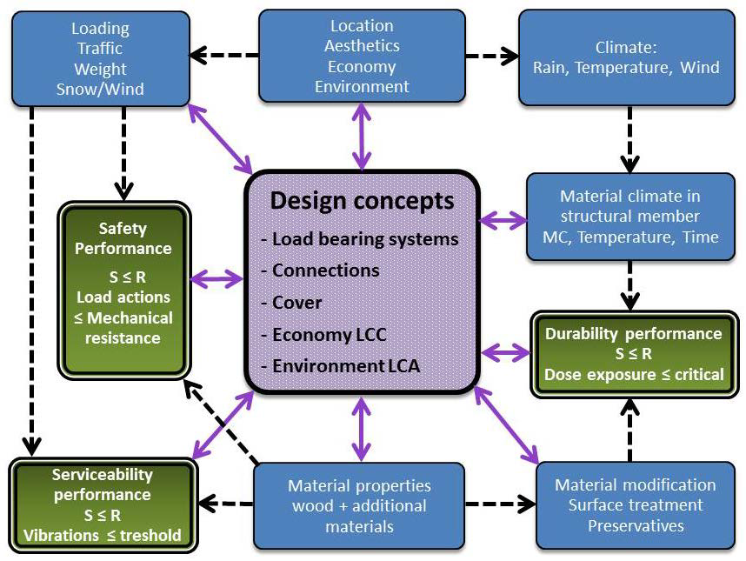
WoodWisdom-Net Seminar – Edinburgh 4-5 April 2017
Project highlights and final results
Notes:
I

Slide 5
WoodWisdom-Net Seminar – Edinburgh 4-5 April 2017
Project highlights and final results
Exposure model: (location, climate and risk of decay)
  validated for a given set of timber bridges
Performance model: microclimate in wooden bridge elements and risk of their decay
  validated for a given set of timber design details
Design concepts for durable timber bridges in the span 10 – 150 m:
  Short/medium span: Pre-stressed timber decks and Timber-Concrete Composites improved
  Network timber arch bridge with spoked hangers developed
Splicing of massive block-glued glulam cross-sections for bridges:
  Two butt-joint options using threaded rods developed
Detailing, performance and maintenance:
  stress-laminated wooden decks improved
  joint details classified and improved
Fatigue strength axial threaded rod connectors:
  Testing performed
Notes:
I

Slide 6
WoodWisdom-Net Seminar – Edinburgh 4-5 April 2017
Expected impact and target groups
Notes:
I

Slide 7
Lessons learnt and open questions
WoodWisdom-Net Seminar – Edinburgh 4-5 April 2017
  Consortium with many partners can be handled (20p)
    Also organized on national level
  Regular 2-3 days consortium meetings
    Total 7 physical meetings (Physical partner meetings are expensive)
    Group meetings
    Skype meetings
  Take long time before PhD students become productive
    (three years duration too short?)
  Industry involvement is very different from partner to partner
    Possibly different views on the weight on short/long term topics among partners.
Notes:
I

