Slide 1
Underpinning the vital role of the forest-based sector in the Circular Bioeconomy
WoodCircus in nutshell
Anne-Christine Ritschkoff
Coordinator: VTT Technical Research Centre of Finland Ltd. / Anne-Christine.Ritschkoff@vtt.fi

Slide 2
WoodCircus facts
Grant Agreement number: 820892
Type of Action: CSA
Topic: CE-SC5-08-2018-2019-2020
Duration: 36 months (3 yrs) 01/11/2018 – 3/10/2021
Maximum EU Contribution : 2 973 953,75 €
Reimbursement rate: 100% for direct costs
Indirect costs (flat rate): 25 % of direct costs (excl. subcontracting) for all organisations

Slide 3
WoodCircus consortium
Part. No * | Participant organisation name | Short Name | Country
1 | VTT Research Centre of Finland Ltd (coordinator) | VTT | FI
2 | FCBA Institut Technologique | FCBA | FR
3 | InnoRenew CoE | IoR | SI
4 | nova-Institut gmbh | NOVA | DE
5 | Fundación Tecnalia Research & Innovation - TECNALIA | TECN | ES
6 | Consorzio del Mobile SCPA | COSMOB | IT
7 | Natural Resources Institute Finland - LUKE | LUKE | FI
8 | InnovaWood asbl | IW | BE
9 | Sahateollisuus ry (The Finnish Sawmills Association) | SAHA | FI
10 | Xilopan S.p.A. | XIL | IT
11 | Alfa Natura d.o.o. | ALFA | SI
12 | Asociación De La Madera De Euskadi - BASKEGUR | BASK | ES
13 | Veolia Proprete France Recycling - VPFR | VEO | FR
14 | Consorzio Nazionale per la raccolta, il recupero e il riciclaggio deli imballaggi di legno - RILEGNO | RIL | IT
15 | EGOIN S.A. | EGO | ES
16 | European Forest-Based Sector Technology Platform | FTP | BE
17 | European Wood-Based Panels Federation - EPF | EPF | BE

Slide 4
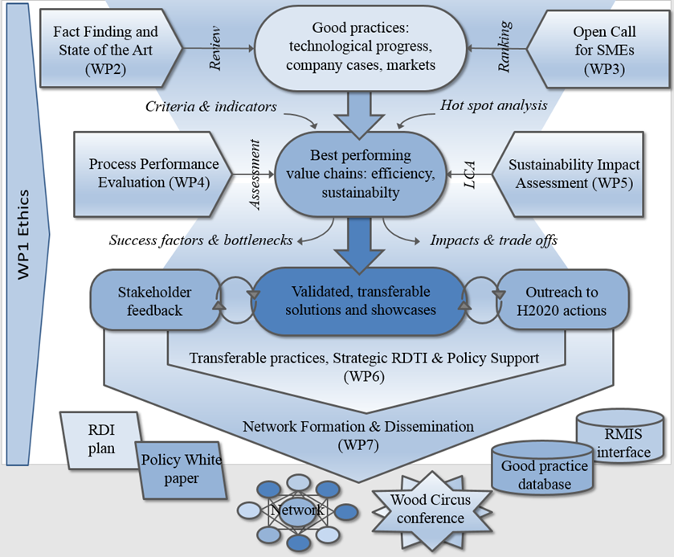
WoodCircus flowchart

Slide 5
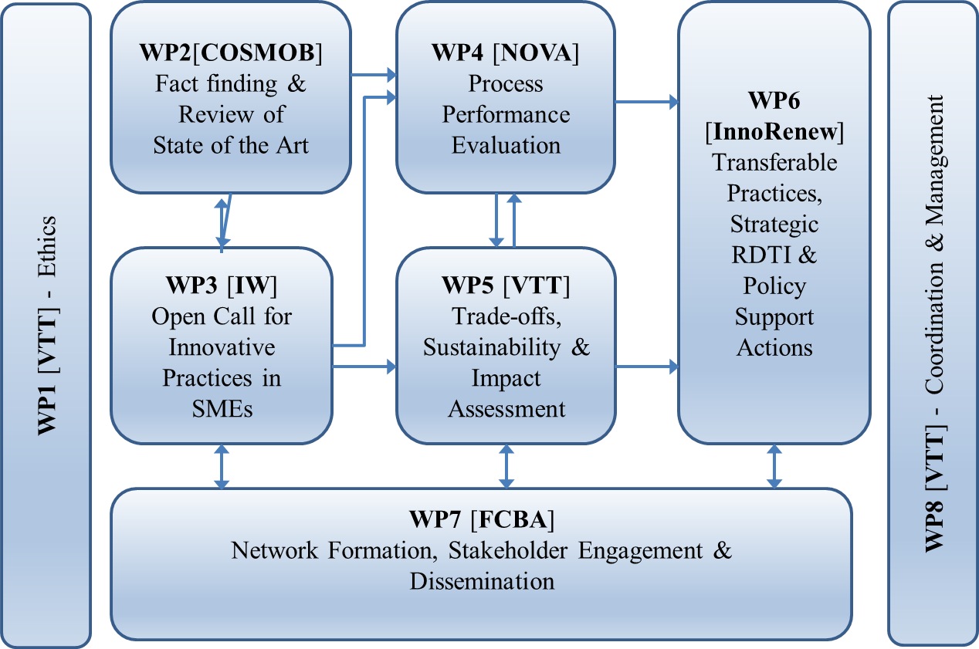
WoodCircus work packages

Slide 6
WoodCircus expected outcomes
Good practice database, a thorough documentation of the state of the art, including an active interface to the European Commission’s Raw Materials Information System (RMIS) and the Bioeconomy Knowledge Centre (BKC)
Open competition and award to SMEs, highlighting individual good practice showcases
Evaluation approach for performance and sustainability assessment, tested on typical value chains
Best performing supply chains typology, validated for broad transfer
RTDI plan for wood industries towards the Circular Economy
White Paper including policy recommendations, endorsed by a broad panel of stakeholders
WoodCircus Network, established on solid commitments from technical institutes, industries and policy makers for follow-up beyond the project lifetime
High Level Conference, a major international event promoting the wood sector in the Circular Economy

Slide 7
Thank you for your attention!
Coordinator: VTT Technical Research Centre of Finland Ltd. / Anne-Christine.Ritschkoff@vtt.fi

